Slide 1
Missing Data & Other Real-World Problems
EDUC 7610
Tyson S. Barrett, PhD
Updated by Carly Fox

Slide 2
Missing data…

Slide 3
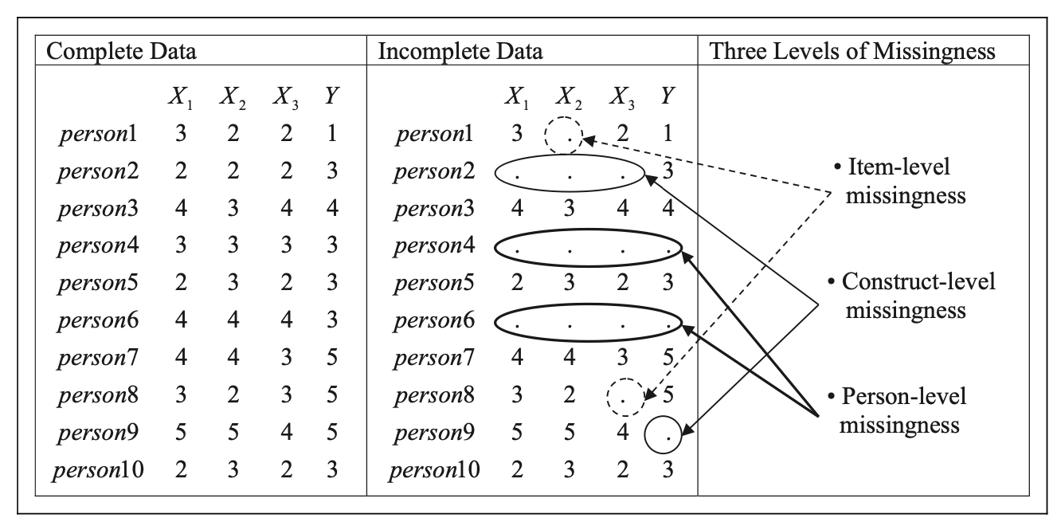
Three Levels of Missing Data
https://www.researchgate.net/profile/Daniel_Newman9/publication/268686755_Missing_Data/links/54737cf50cf2778985abb52b/Missing-Data.pdf

Slide 4
Three Mechanisms of Missing Data
Missing Completely At Random
(MCAR)
Missing At Random
(MAR)
Missing Not At Random
(MNAR)
The missing values are totally random or have nothing to do with the study and are not related to the missing values themselves
The missing values are partly related to variables measured in the study but are not related to the missing values themselves
The missing values are not random at all and are related to the missing values themselves
“... missing data are almost never missing completely randomly (MCAR)” – Newman, 2014, pg 377

Slide 5
The missing values are totally random or have nothing to do with the study and are not related to the missing values themselves
Missing Completely At Random
Examples
A random internet outing occurred while a participant was taking the online survey
Some participants are color blind and could not accurately see the stimulus in the experiment (the study has nothing to do with color blindness)
You randomly assign individuals to miss different parts of the survey (given it is so long you were concerned about fatigue)

Slide 6
The missing values are partly related to variables measured in the study but are not related to the missing values themselves
Missing At Random
Examples
Some individuals did not show up for one of the experiments because they have children home from school that day (your study includes measures about their family)
Individuals with disabilities do not complete the survey due to lack of accessibility for some of the items (you measure disability status and the study is not about individuals with disabilities)

Slide 7
Missing Not At Random
The missing values are not random at all and are related to the missing values themselves
Examples
Some individuals did not show up for one of the experiments about health because they had a marathon that they were participating in
People in the control group stop participating
Some claim the GRE has nothing to do with student performance in graduate school but all those that scored low on the GRE are not in graduate school (therefore they are missing)
Notes:
library(tidyverse)
set.seed(843)
df <- data_frame(
x1 = runif(100),
x2 = rbinom(100, 1, .5),
y = x1 + x2 + 2*x1*x2 + rnorm(100)
)
df %>%
mutate(x2_cat = factor(x2)) %>%
ggplot(aes(x1, y, group = x2_cat, color = x2_cat)) +
geom_point() +
geom_smooth(method = "lm")

Slide 8
How can we handle missing data?
Case-wise Deletion
Easiest (default) but not the ideal
Multiple Imputation
or
FIML
Better in Most Situations but more difficult

Slide 9
How can we handle missing data?
Case-wise Deletion
Perform similarly when you have MAR (when you have measured variables that tell us about the missingness)
Easiest (default) but not the ideal
Multiple Imputation
or
FIML
Better in Most Situations but more difficult

Slide 10
Examples of FIML and Multiple Imputation
You may recall from the previous in-class activity that the GSS dataset had missing data, but we used case-wise deletion to only examine observations with complete data
Let’s say we didn’t do that, how could we proceed using FIML or Multiple Imputation? (Making the assumption that the data is MAR and, after applying a log transformation, now follows a normal distribution)
Notes:
library(educ7610)
library(tidyverse)
data(gss)
gss = mutate(gss,
log_income = log(income06),
log_educ = log(educ)) %>%
mutate(log_income = furniture::washer(log_income, is.na, is.nan, is.infinite),
log_educ = furniture::washer(log_educ, is.nan, is.infinite))
library(lavaan)
mod <- 'log_income ~ age + log_educ'
sem(mod, data = gss, missing = 'fiml', fixed.x = FALSE) %>%
summary()
library(mice)
impute_GSS <- gss %>%
select(log_income, age, log_educ) %>%
mice(m = 5, maxit = 50, method = 'pmm', seed = 50)
fit <- with(data = impute_GSS, exp = lm(log_income ~ age + log_educ))
combine <- pool(fit)
summary(combine)

Slide 11
FIML – with the GSS Dataset
First we subset the GSS dataset to only include the numerical variables income, education and age; then we use the lavaan package to compute a regression with imputed missing values using FIML
library(lavaan)
mod <- 'log_income ~ age + log_educ'
sem(mod, data = gss, missing = 'fiml', fixed.x = FALSE) %>%
summary()

Slide 12
FIML – with the GSS Dataset
First we subset the GSS dataset to only include the numerical variables income, education and age; then we use the lavaan package to compute a regression with imputed missing values using FIML
Resulting in the following output:
log_income ~ Estimate Std. Error z-value P(>|z|)
age 0.000 0.001 0.217 0.828
log_educ 1.450 0.091 15.998 0.000***

Slide 13
Multiple Imputation – with the GSS dataset
Using the MICE package, we can also impute the missing income data using multiple imputation, which produces 5 (or however many) iterations of imputed values each of which will result in a different model…
You can then consolidate the 5 models into one pooled model
library(mice)
impute_GSS <- gss %>%
select(log_income, age, log_educ) %>%
mice(m = 5, maxit = 50, method = 'pmm', seed = 50)
fit <- with(data = impute_GSS, exp = lm(log_income ~ age + log_educ))
combine <- pool(fit)
summary(combine)

Slide 14
Multiple Imputation – with the GSS dataset
Using the MICE package, we can also impute the missing income data using multiple imputation, which produces 5 (or however many) iterations of imputed values each of which will result in a different model…
You can then consolidate the 5 models into one pooled model
library(mice)
impute_GSS <- gss %>%
select(log_income, age, log_educ) %>%
mice(m = 5, maxit = 50, method = 'pmm', seed = 50)
fit <- with(data = impute_GSS, exp = lm(log_income ~ age + log_educ))
combine <- pool(fit)
summary(combine)

Slide 15
Multiple Imputation – with the GSS dataset
Using the MICE package, we can also impute the missing income data using multiple imputation, which produces 5 (or however many) iterations of imputed values each of which will result in a different model…
You can then consolidate the 5 models into one pooled model
Resulting in the following output:
term estimate std.error statistic df p.value
(Intercept) 7.3299124658 0.294620940 24.8791293 23.76547 0.000000e+00
age -0.0009509144 0.001656267 -0.5741312 27.57720 5.705327e-01
log_educ 1.2557312736 0.101383546 12.3859475 36.75509 1.110223e-14

Slide 16
Note…
These results are not identical, but the coefficients are similar, and the p-values lead to the same conclusion
Resulting in the following output:
log_income ~ Estimate Std. Error z-value P(>|z|)
age 0.000 0.001 0.217 0.828
log_educ 1.450 0.091 15.998 0.000***
Resulting in the following output:
term estimate std.error statistic df p.value
(Intercept) 7.3299124658 0.294620940 24.8791293 23.76547 0.000000e+00
age -0.0009509144 0.001656267 -0.5741312 27.57720 5.705327e-01
log_educ 1.2557312736 0.101383546 12.3859475 36.75509 1.110223e-14

Slide 17
Other Real-World Problems
Several other topics deserve attention (although we won’t have time to go into depth for any of them)
Likert Data
Categorical continuous variables (e.g., ages 3-5, 6-10)
Select all that apply questions
Rank order questions
Zero-value transformations

Slide 18
Other Real-World Problems
Several other topics deserve attention (although we won’t have time to go into depth for any of them)
Likert Data
Examples
“Strongly Disagree to Strong Agree questions”
“Rating from 1 to 7”
They aren’t truly continuous and often have weird distributions (ceiling and floor effects)
Most recommend to treat like an ordinal variable (not continuous) but if the distribution is roughly normal and there are more than 7 options, then sometimes this can be relaxed
Categorical continuous variables (e.g., ages 3-5, 6-10)
Select all that apply questions
Rank order questions
Zero-value transformations
Just a rule of thumb

Slide 19
Other Real-World Problems
Several other topics deserve attention (although we won’t have time to go into depth for any of them)
Likert Data
Take a look at the `likert` package in R for great examples of how to analyze these in really beautiful ways (mostly descriptive though)
https://rpubs.com/m_dev/likert_summary
Categorical continuous variables (e.g., ages 3-5, 6-10)
Select all that apply questions
Rank order questions
Zero-value transformations

Slide 20
Other Real-World Problems
Several other topics deserve attention (although we won’t have time to go into depth for any of them)
Likert Data
Best if treated like ordinal/categorical but you’ll see some turn them into a continuous variable
Treating like continuous introduces measurement error
Categorical continuous variables (e.g., ages 3-5, 6-10)
Select all that apply questions
Rank order questions
Zero-value transformations

Slide 21
Other Real-World Problems
Several other topics deserve attention (although we won’t have time to go into depth for any of them)
Likert Data
All variables need to have a single, mutually exclusive value
One way is to create a variable for each option in a select all that apply
Other way is to code them as single answer, 2 answers, 3 answers, etc.
Or you can combine both approaches
Categorical continuous variables (e.g., ages 3-5, 6-10)
Select all that apply questions
Rank order questions
Zero-value transformations

Slide 22
Other Real-World Problems
Several other topics deserve attention (although we won’t have time to go into depth for any of them)
Likert Data
Categorical continuous variables (e.g., ages 3-5, 6-10)
Questions that look like:
“Rank all the following items as least enjoyed to most enjoyed”
Can take average rank (if we think the ranks are truly continuous), the median rank, or the mode
Select all that apply questions
Rank order questions
Zero-value transformations

Slide 23
Other Real-World Problems
Several other topics deserve attention (although we won’t have time to go into depth for any of them)
When you need to use a log or other type of transform that cannot have a zero but your variable has zeroes in it
It complicated but here are three potential solutions:
Use another transformation that will work (e.g., square root)
GLMs (discussed later in the class)
Add a small constant to the variable
Likert Data
Categorical continuous variables (e.g., ages 3-5, 6-10)
Select all that apply questions
Rank order questions
Zero-value transformations
We talk about log transformations and other non-linear models later on

Slide 24
Check Out These Resources!
Note that this lecture was just an introduction to these ideas and approaches!
Practical Paper about Missing Data
Multiple Imputation using Mice Package in R Tutorial
FIML Using Lavaan in R Tutorial

Slide 25
Notes:
Escalante Petrified Forest State Park

